Slide 1
Module 3.2: Nearest Neighbors, Decision Trees and Random Forest
Dennis J. Zhang
Washington University in St. Louis

Slide 2
XGBOOST
Introduction
Basic Walkthrough
Real World Application
Tuning

Slide 3
Introduction
XGBoost is short for eXtreme Gradient Boosting.
It is:
An open-sourced tool:
Computation is done in C++, Interface to R/Python
A variant of the gradient boosting tree-based models.
The winning models of several Kaggle competitions.
GitHub: https://github.com/tqchen

Slide 4
Introduction
XGBoost is widely used for Kaggle competitions. The reason to choose XGBoost includes
Easy to use
Easy to install.
Highly developed R/python interface.
Efficiency
Automatic parallel computation on a single machine.
Can be run on a cluster.
Accuracy
Good result for most datasets.
Feasibility
Customized objective and evaluation
Tunable parameters

Slide 5
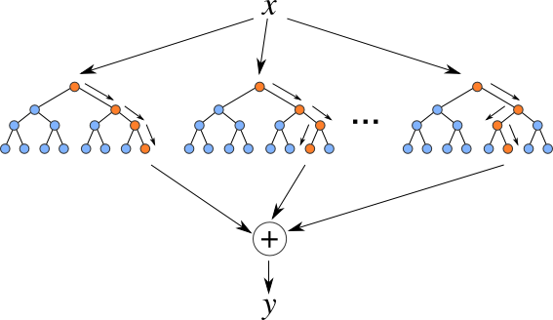
XGBoost Logic
Additive tree model: add new trees that complement the already-built ones
Response is the optimal linear combination of all decision trees
Popular in Kaggle competitions for efficiency and accuracy

Slide 6
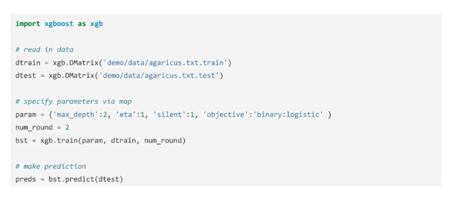
Basic Walkthrough

Slide 7
Real-world Examples
The debut of XGBoost is at Higgs Boson Competition
The goal of the Higgs Boson Machine Learning Challenge is to explore the potential of advanced machine learning methods to improve the discovery significance of the experiment. Using simulated data with features characterizing events detected by ATLAS, your task is to classify events into "tau tau decay of a Higgs boson" versus "background."
$13,000
Simple XGBoost script is introduced to achieve top 10% performance in 2014.

Slide 8
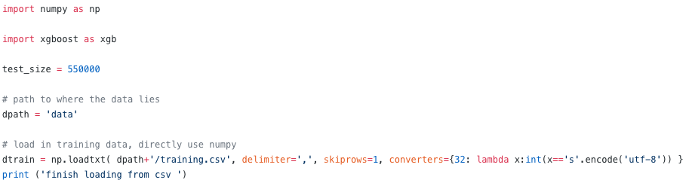
Real-world Examples

Slide 9
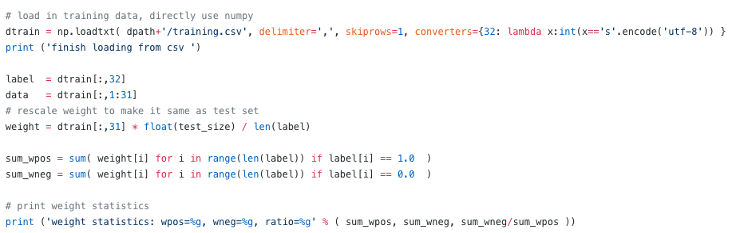
Real-world Examples

Slide 10
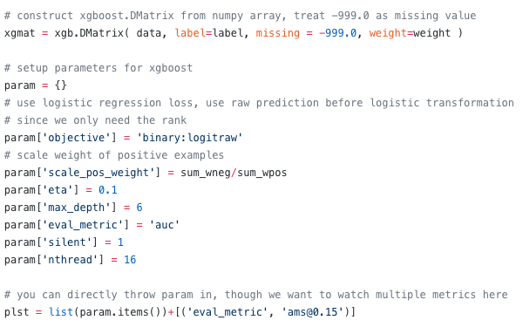
Real-world Examples

Slide 11
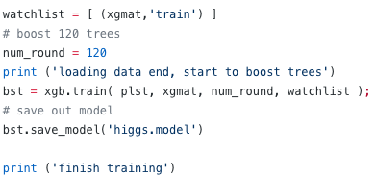
Real-world Examples

Slide 12
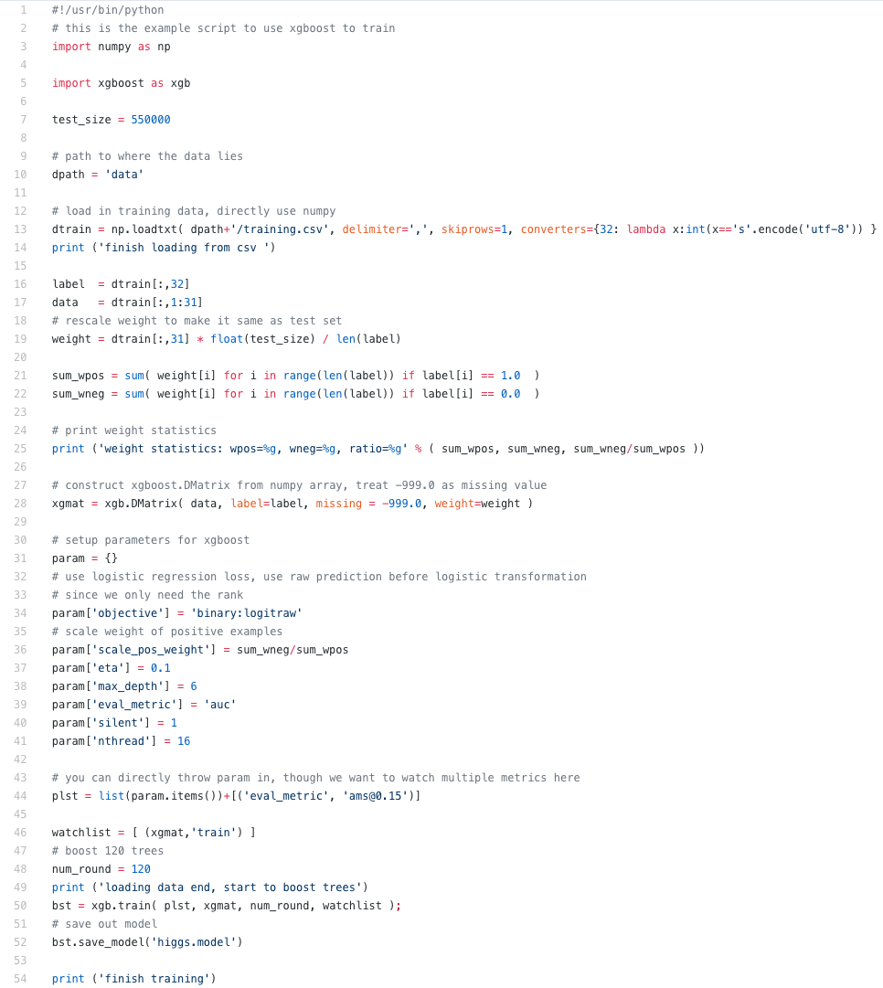
Real-world Examples
https://github.com/dmlc/xgboost/blob/master/demo/kaggle-higgs/higgs-numpy.py

Slide 13
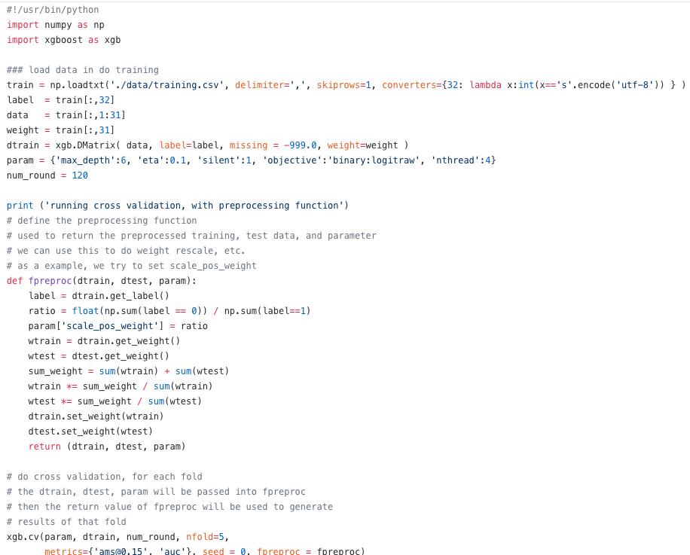
Real-world Examples

Slide 14
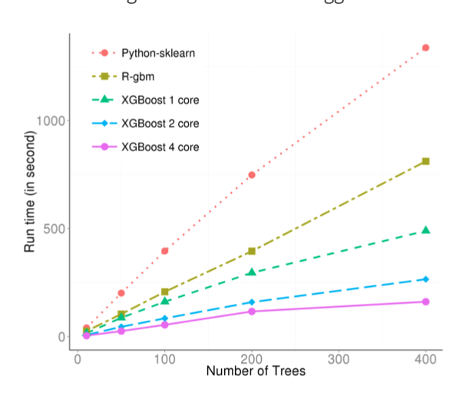
Running Time

Slide 15
Real-world Examples
Below is a blog post of a person using XGBoost for the same contest with proper feature engineering and parameter tuning.
He achieves 26th position among all participants.
https://no2147483647.wordpress.com/2014/09/17/winning-solution-of-kaggle-higgs-competition-what-a-single-model-can-do/
Hyper-parameters:
Eta = 0.1
Max_depth = 9
Sub_sample = 0.9
Num_rounds = 3000

Slide 16
Parameter Tuning
General Parameters:
nthread: Number of parallel threads
booster:
gbtree: tree-based model
gblinear: linear function

Slide 17
Parameter Tuning
Parameter for Tree Booster:
eta:
Step size shrinkage used in update to prevents overfitting.
Range in [0, 1], default 0.3
gamma:
Minimum loss reduction required to make a split
Range [0, infy], default 0
max_depth:
Maximum depth of a tree, default 6.
subsample
Subsample ratio of the training instance, default 1.
Colsample_bytree
Subsample ratio of columns when constructing a tree, default 1.

Slide 18
Parameter Tuning
Parameter for linear booster:
lambda:
L2 regularization term on weights, default 0
alpha:
L1 regularization term on weights, default 0
lambda_bias:
L2 regularization term on bias, default 0

Slide 19
Parameter Tuning
Parameters for Objectives:
“reg:linear”: linear regression, default option.
“binary:logistic”, logistic regression for binary classification, output probability.
“multi:softmax”, multiclass classification using the softmax objective, need to specify num_class
User specified objective.

Slide 20
Parameter Tuning
Evaluation Metric:
rmse
logloss
error
auc
merror
mlogloss
User specified evaluation metric

Slide 21
Guide on Parameter Tuning
It is almost impossible to give a set of universal optimal parameters.
The key points:
Control Overfitting
Deal with Imbalanced data
Trust the cross validation
Ways to control overfitting:
Controlling the model complexity:
max_depth, gamma
Robust to noise:
Subsample, colsample_bytree

Slide 22
Guide on Parameter Tuning
Scaling the data if it is imbalanced:
Balance the positive and negative weights, by scale_pos_weight
Use “auc” as the evaluation metric
To select the ideal parameter, use cross-validation error from xgb.cv:
Use early.stop.round to detect continuously being worse on a test
If overfitting, reduce eta and increase nround at the same time.

Slide 23
Kaggle Winning Solution
Google Cloud & NCAA® ML Competition 2018-Women’s Apply machine learning to NCAA® March Madness
Google Cloud and NCAA® have teamed up to bring you this year’s version of the Kaggle machine learning competition. Another year, another chance to anticipate the upsets, call the probabilities, and put your bracketology skills to the leaderboard test. Kagglers will join the millions of fans who attempt to forecast the outcomes of March Madness® during this year's NCAA Division I Men’s and Women’s Basketball Championships. But unlike most fans, you will pick your bracket using a combination of NCAA’s historical data and your computing power, while the ground truth unfolds on national television.
Stage 1 - You should submit predicted probabilities for every possible matchup in the past 4 NCAA® tournaments (2014-2017).
Stage 2 - You should submit predicted probabilities for every possible matchup before the 2018 tournament begins.
https://www.kaggle.com/c/womens-machine-learning-competition-2018

Slide 24
Kaggle Winning Solution
Data 1: This section provides everything you need to build a simple prediction model and submit predictions.
Team ID's and Team Names
Tournament seeds since 1997-98 season
Final scores of all regular season, conference tournament, and NCAA® tournament games since 1997-98 season
Season-level details including dates and region names
Example submission file for stage 1
Data 2: This section provides city locations of all regular season, conference tournament, and NCAA® tournament games since the 2014-15 season

Slide 25
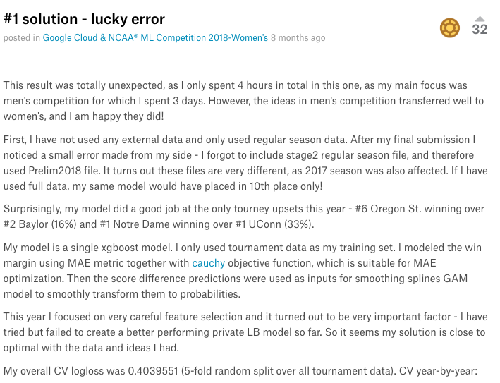
Kaggle Winning Solution

Slide 26
Other alternative models
To judge which machine learning model you should use for ”street fighting”, you need to look at their performances on Kaggle
For example, here is a summary of recent winners:
https://www.kaggle.com/sudalairajkumar/winning-solutions-of-kaggle-competitions
Neural-network based models are good for image, video and audio
XGBoost and LightGBM are good for other data structure.
Feature engineering and Tuning are much more important than selecting the model.

